Slide 1
SUMMER ANALYTICS 2026 · CELONIS CAPSTONE
Decarbonizing Travel
NET ZERO
A Data-Driven Roadmap to Net Zero by 2030
Celonis spent $140M on business travel. 29% of those emissions are immediately avoidable.
178M kg CO₂e
25%
52M kg/yr
Total Emissions
High-Carbon Trips
Addressable Reduction
TOP INSIGHTS
TOP RECOMMENDATIONS
Business & First Class flights = 44% of CO₂, 25% of trips
Mandate Economy class → save 34.7M kg/yr
APAC (AU, CN, BR) accounts for 66% of total emissions
AI approval gates to block OOP bookings → save 13.2M kg/yr
18.4% of trips are Out-of-Policy — 1,100 kg excess CO₂ each
Rail-first policy for EU/intra-region routes
Vaibhav Soni · Summer Analytics 2026 · IIT Guwahati x Celonis

Slide 2
Emissions Profile
Key Question 1: What does Celonis' current carbon footprint look like?
178M kg
65,289
2,728 kg
25.0%
18.4%
Total CO₂e
Business Trips
Avg CO₂ / Trip
High-Carbon Trips
Out-of-Policy Rate
Scope 3 Travel Emissions
Across all regions & BUs
Equivalent: 15,000 km by car
16,326 trips above threshold
12,005 non-compliant trips
CO₂e by Transport Mode (kg)
KEY INSIGHT
✈
Flights = 83.9% of all CO₂e (149M kg) but 66% of trips
💼
Business Class alone = 41% of total CO₂, despite being avoidable
🚂
Trains emit 445 kg avg vs 4,865 kg for Business Class — 10.9x difference
⚡
EV (Fiat 500) = lowest road CO₂ at 1,066 kg avg. 36% less than diesel car
Business Class + First Class = 79.7M kg CO₂e — 44.7% of total emissions. Both are avoidable through policy.

Slide 3
Regional Benchmarking
Key Question 2: How do travel processes compare across North America, Europe, and Asia?
APAC
LATAM
NA
Europe
Africa
117.2M kg
39.7M kg
14.6M kg
5.4M kg
1.1M kg
Total CO₂e
Total CO₂e
Total CO₂e
Total CO₂e
Total CO₂e
Share:
65.8%
Share:
22.3%
Share:
8.2%
Share:
3.1%
Share:
0.6%
Trips:
30,652
Trips:
14,674
Trips:
9,505
Trips:
9,047
Trips:
1,411
OOP Rate:
15.2%
OOP Rate:
11.6%
OOP Rate:
30.1%
OOP Rate:
27.8%
OOP Rate:
19.8%
High-Carbon:
40.4%
High-Carbon:
20.9%
High-Carbon:
9.2%
High-Carbon:
0.0%
High-Carbon:
0.0%
HIGHEST EMITTER
2ND EMITTER
HIGH OOP RATE
CLEANEST TRAVEL
LOWEST VOLUME
REGIONAL INSIGHT
APAC:
NA:
Europe:
Australia alone emits 89.4M kg — 50% of Celonis' total. Long-haul intercontinental flights at business class are the primary driver.
30.1% OOP rate (highest globally). Greater automation of pre-approval in US can prevent high-emission, non-compliant bookings.
0% High-Carbon trips, 601 kg avg CO₂ — enabled by rail availability. Europe proves that low-carbon travel at scale is achievable.

Slide 4
Hotspot Identification
Key Question 3: Which regions, business units, and travel purposes drive disproportionate emissions?
CO₂e by Business Unit (M kg)
CO₂e by Trip Purpose
Customer Visit
76.9M kg (43.2%)
Conference/Exhibition
63M kg (35.4%)
Internal Business Trip
20.4M kg (11.5%)
Enablement
12.6M kg (7.1%)
Partner Visit
🔴 EMISSION HOTSPOTS
5.1M kg (2.8%)
💼
Business Class Flights
🌏
APAC Long-Haul
👤
Customer Visits
⚠
NA Out-of-Policy
48% OOP rate + 4,865 kg avg CO₂. Sales BU is the top booker.
AU and CN combined = 65% of all emissions. All flights, no rail alternative.
43% of total CO₂. Sales-driven urgency leads to premium class bookings.
30.1% OOP — highest globally. Pre-approval gaps let high-carbon trips through.

Slide 5
Process Pain Points & Inefficiencies
Key Question 4: Where are the operational bottlenecks driving excess emissions?
68K
65K
63K
63K
63K
63K
60K
42K
11K
TRAVEL PROCESS FLOW — Volume at Each Stage
Book Transport
Book Lodging
Submit Request
Manager Pre-Approve
Approved
Travel
Expense Submit
Expense Approved
Reimbursement
12,005
2,441
11,691
Out-of-Policy Trips
Mode of Transport Changes
Trips with Changes/Edits
18.4% non-compliant
1,100 kg excess CO₂ each
Booking wrong mode first
Process waste + rebooking emissions
17.9% of all trips modified
Last-minute changes = premium prices
9.2%
3,993
47%
Trip Extensions
Disrupted Trips
BC Trips are OOP
5,989 extensions approved
No carbon impact review at extension
6.1% face cancellations/delays
Missed flights = rebooking in higher class
Business Class has highest
non-compliance rate of any mode

Slide 6
Actionable Recommendations
Key Question 5: What specific policy updates should be made and what value will they generate over 3 years?
✈ Economy-First Flight Policy
34.7M kg/yr saved
⚙ AI-Powered OOP Prevention Gate
13.2M kg/yr saved
Mandate Economy Class for all trips by default
Deploy Celonis AI agent at booking submission
Business Class requires VP+ sign-off + justification
Auto-reject OOP requests without pre-approval
AI flag at booking stage if premium class selected without approval
Real-time carbon score shown before confirmation
📊 Business Class → Economy: 15,035 trips × (4,865−2,555) = 34.7M kg/yr
📊 12,005 OOP trips × 1,100 kg excess = 13.2M kg/yr recovered
🚂 Rail-First for Intra-Europe Routes
4.1M kg/yr saved
⚡ EV Rental Standard in Target Markets
2.4M kg/yr saved
All EU intra-continental routes <6hr → mandatory train
Replace BMW/VW diesel fleet cars with EV where available
Celonis workflow auto-routes to rail options
Fiat EV = 1,066 kg vs BMW diesel 1,664 kg (36% lower)
Train CO₂ = 445 kg vs 2,554 kg economy flight (5.7x)
Phase diesel cars out of UK, DE, NL by 2026
📊 European flights → train conversion; 0% high-carbon in Europe proves rail works
📊 6,648 diesel rentals × 598 kg avg difference = 3.97M kg potential

Slide 7
Strategic Roadmap to Net Zero
3-Year Implementation Timeline & Projected Carbon Impact
2026
QUICK WINS
2027
SCALE & OPTIMIZE
2028+
NET ZERO TARGET
Deploy Celonis AI booking gate (OOP block)
EV rental fleet standard in EU + NA
Carbon offsetting for unavoidable APAC long-haul
Economy-class default policy enforced
Video-first policy for internal meetings
AI route optimizer suggests greenest itinerary
Carbon score shown at all booking touchpoints
Supplier carbon SLA in contract negotiations
Annual BU carbon budget allocated & enforced
Rail-first mandate for EU corridors
Real-time BU dashboards tracking carbon budget
External GHG Protocol reporting & audit
TARGET: 47.9M kg/yr
TARGET: +22M kg/yr additional
TARGET: Net Zero trajectory
Projected Cumulative CO₂e Reduction (M kg)
Total 3-Year CO₂ Reduction
155.9M kg saved by 2028
= 87% of current annual footprint

Slide 8
Part B: High-Carbon Trip Prediction Model
Binary classifier to predict high-carbon trips before booking — enabling pre-emptive intervention
MODEL ARCHITECTURE
FEATURE ENGINEERING
Algorithm
Ensemble: XGBoost + LightGBM + RandomForest
Transport Flags
Is_Business_Class, Is_First_Class, Is_Flight, Is_Train, Is_EV
Training Data
65,289 trips (public dataset)
Policy Signals
OutOfPolicy_binary, Is_PreApproved, Mode_Changed (event log)
Class Balance
75% Low-Carbon / 25% High-Carbon
Route Features
Same_Region, Same_Country, Hotel_Nights
Evaluation
5-Fold Stratified Cross-Validation
Business Context
BU_encoded, Purpose_encoded, EntityCode
Metric
ROC-AUC (Primary) + F1 Score
Process Events
Trip_Extension_flag, Change_Event_count, Disruption_flag
Threshold
OOF-tuned for optimal F1
Cost Features
NetCosts, Cost_per_Night, Relative_cost_BU_avg
Prohibited Feats
CO₂e columns excluded (per guidelines)
HIGH-CARBON RATE BY TRANSPORT MODE
MODEL RESULT
ShippingTypeDescription is the #1 predictor of HighCarbon classification. First Class (63%) and Business Class (56%) have near-certain high-carbon outcomes. Training without CO₂e columns, the model learns from transport mode, policy compliance, BU context, and process event signals.

Slide 9
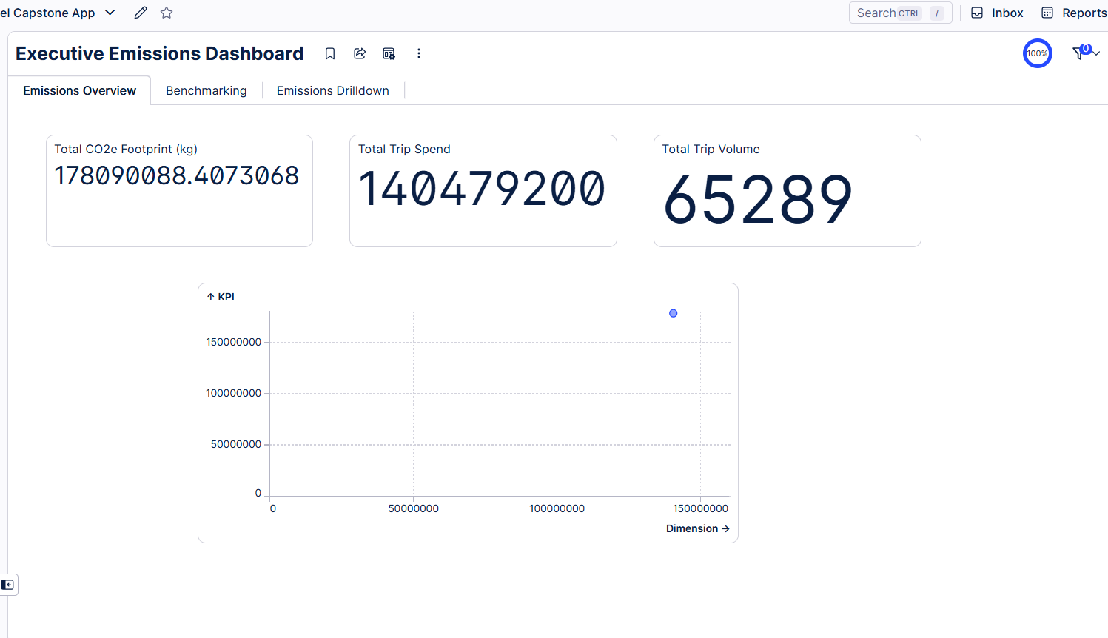
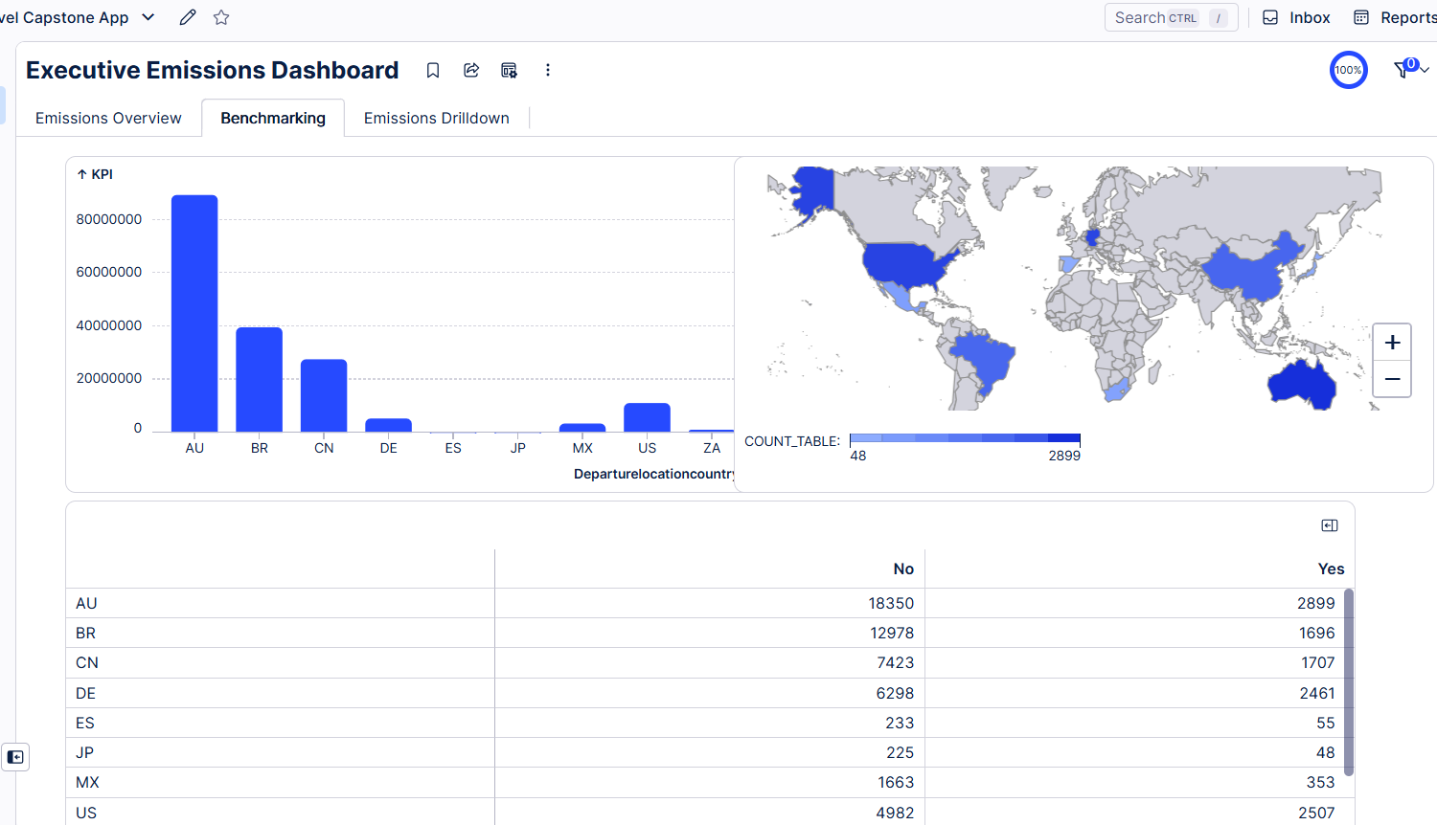
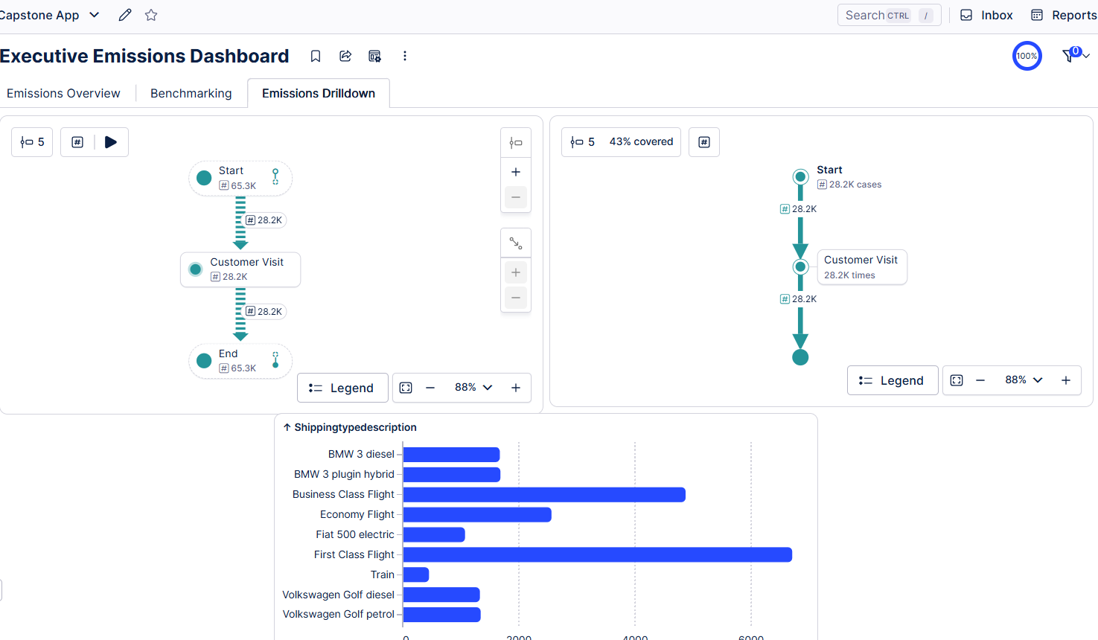
Celonis Dashboard — Live Demo
Three mandatory views: Emissions Overview · Benchmarking · Emissions Drilldown
Tab 1: Emissions Overview
Tab 2: Benchmarking
Tab 3: Emissions Drilldown
[ Screenshot: Total CO₂e KPI cards, trip volume, high-carbon rate, cost vs emissions scatter ]
[ Screenshot: Regional comparison bar charts, APAC vs EU vs NA vs LATAM, OOP rate heatmap ]
[ Screenshot: BU × Purpose matrix, transport mode breakdown, process variant analysis, flight class comparison ]

Slide 10
Results at a Glance
GreenTravel Intelligence Challenge · Vaibhav Soni · Summer Analytics 2026
178M kg
52M kg
156M kg
87%
Current Annual
CO₂e Footprint
Year-1 Reducible
(Policy Changes)
3-Year Total
Reduction Potential
Of Footprint
Addressable by 2028
✅ ALL 5 KEY BUSINESS QUESTIONS ADDRESSED
Emissions Profile: 178M kg CO₂e across 65,289 trips — flights are 83.9% of total
Regional Benchmarking: APAC = 65.8%, Europe = 0% high-carbon thanks to rail
Hotspot Identification: Sales BU + Business Class flights + Customer Visits = core problem
Pain Points: 18.4% OOP, 17.9% trips modified, 47% of BC flights are non-compliant
Recommendations: Economy-first policy + AI gate + rail mandate = 52M kg/yr saved
🎯 BONUS: External Benchmark — IATA reports avg 295g CO₂/km for economy flights. Celonis' avg 2,554 kg economy trip implies ~8,640km avg flight distance, consistent with APAC-heavy travel pattern confirmed by data.

